Slide 1
Email Spam Detection using NLP
Author :
Parija Deshmukh

Slide 2
Email spam classification using NLP
Most of us consider spam emails as one which is annoying and repetitively used for purpose of advertisement and brand promotion. We keep on blocking such email-ids but it is of no use as spam emails are still prevalent.
Some major categories of spam emails that are causing great risk to security, such as fraudulent e-mails, identify theft, hacking, viruses, and malware.
In order to deal with spam emails, we need to build a robust real-time email spam classifier that can efficiently and correctly flag the incoming mail spam, if it is a spam message or looks like a spam message. The latter will further help to build an Anti-Spam Filter.

Slide 3
Problem Statement
Our goal is to build a prototype of robust real-time email spam classifier that can efficiently and correctly flag the incoming mail spam, if it is a spam message or looks like a spam message so that it can be controlled and restricted in terms of risk in security.

Slide 4
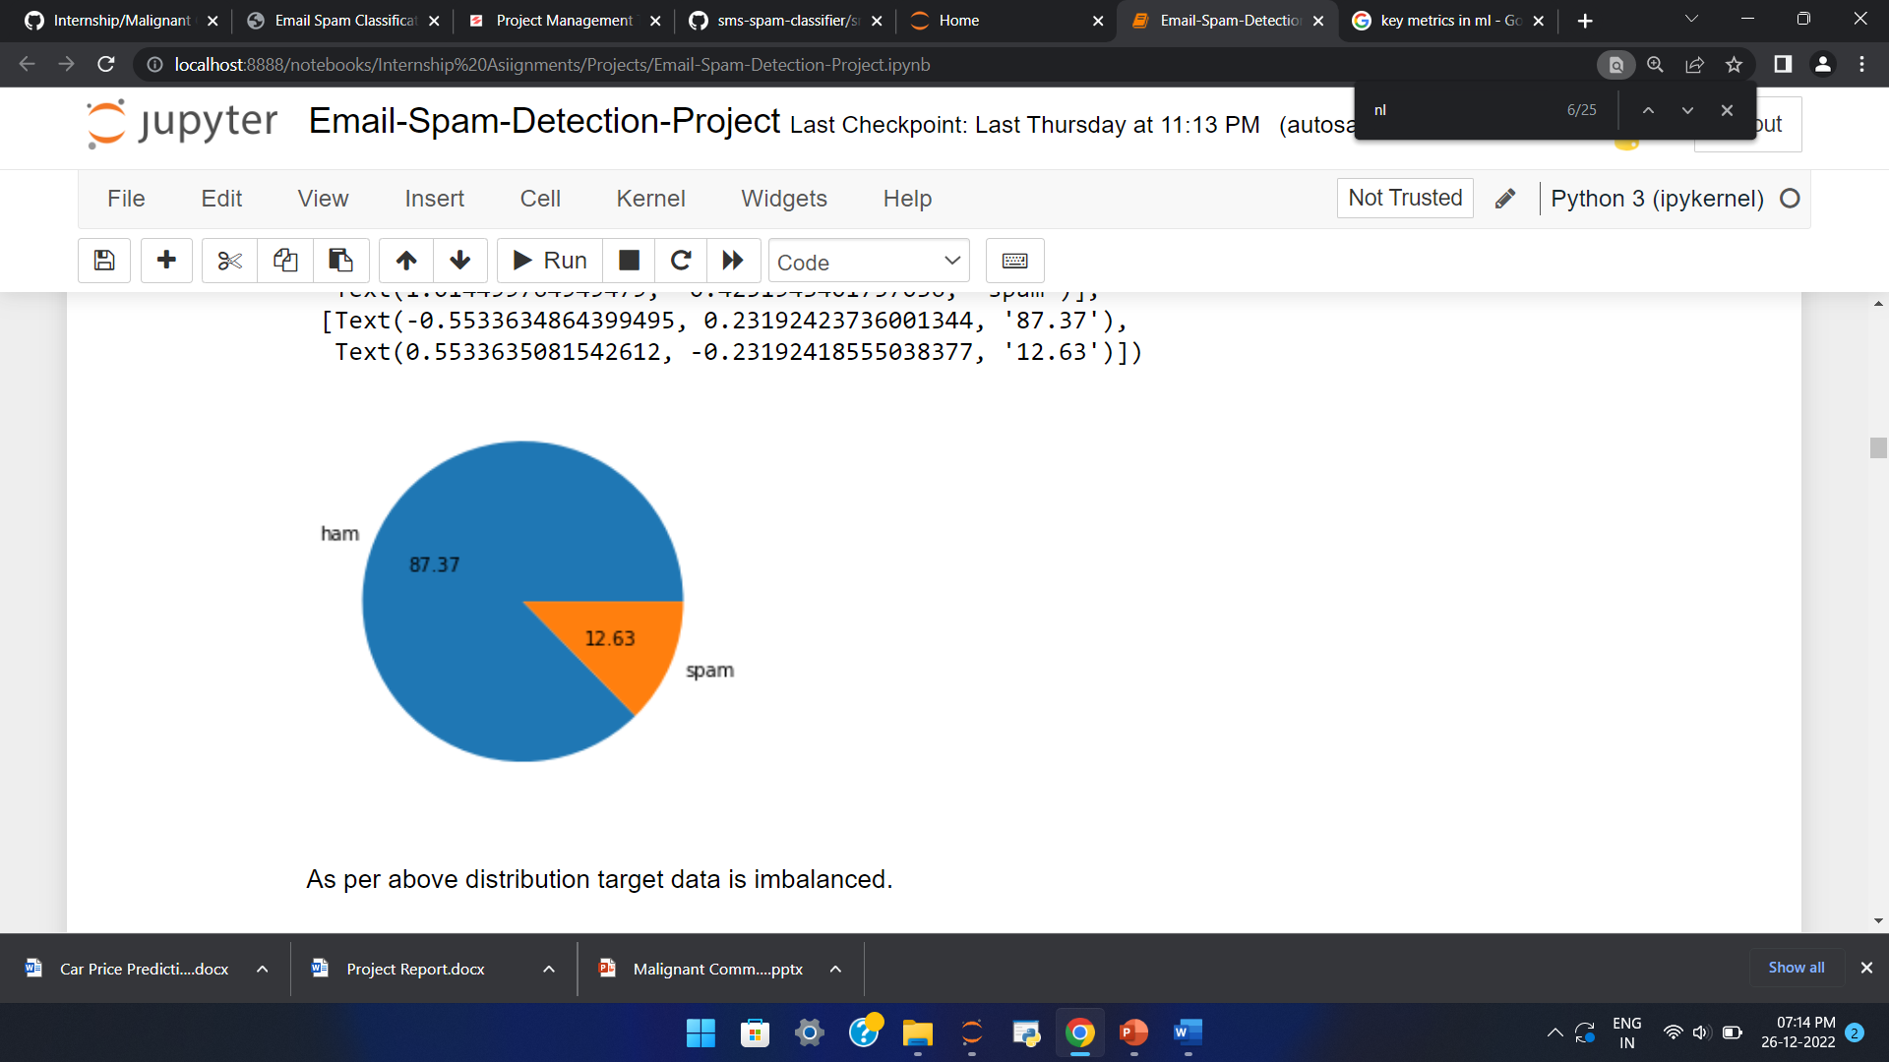
Exploration of Target Variable Ratings
Out of total emails around 87.37% are ham and 12.63% are spam emails.

Slide 5
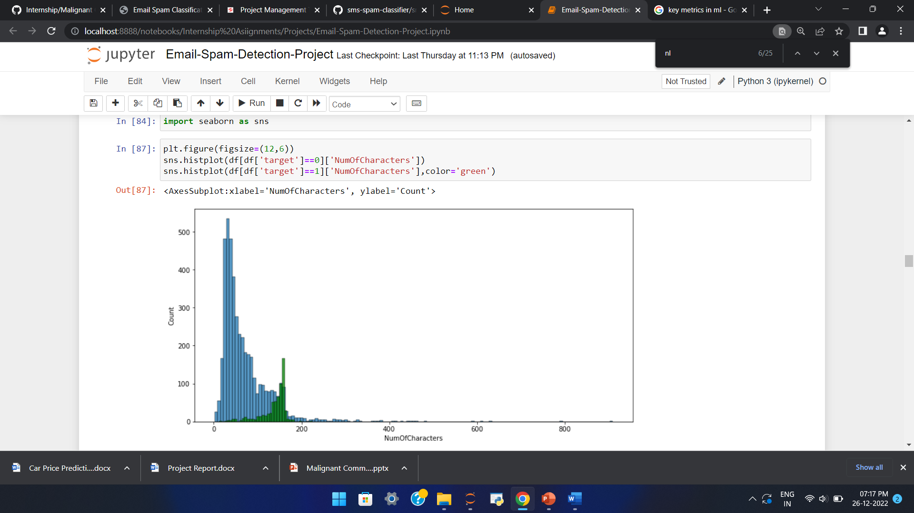
Above is a plot showing the comparison between number of characters spam/ham emails consists of.
Majority of the spam emails contains greater number of characters.

Slide 6
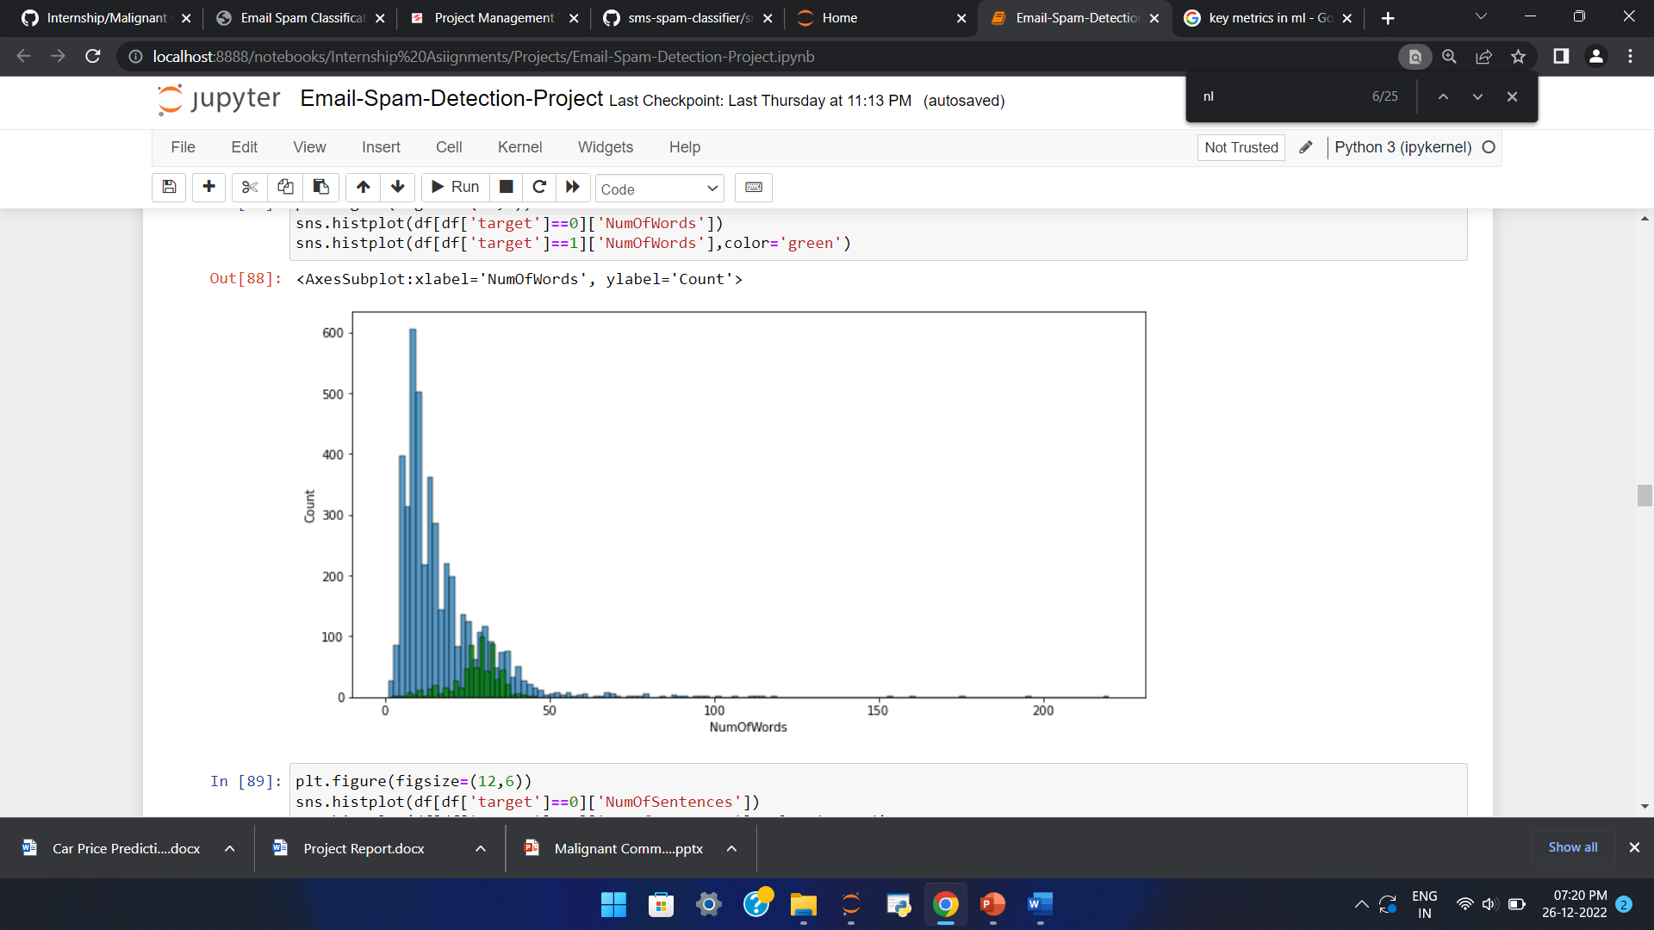
Above is a plot showing the comparison between number of words spam/ham emails consists of.
Majority of the spam emails contains greater number of words.

Slide 7
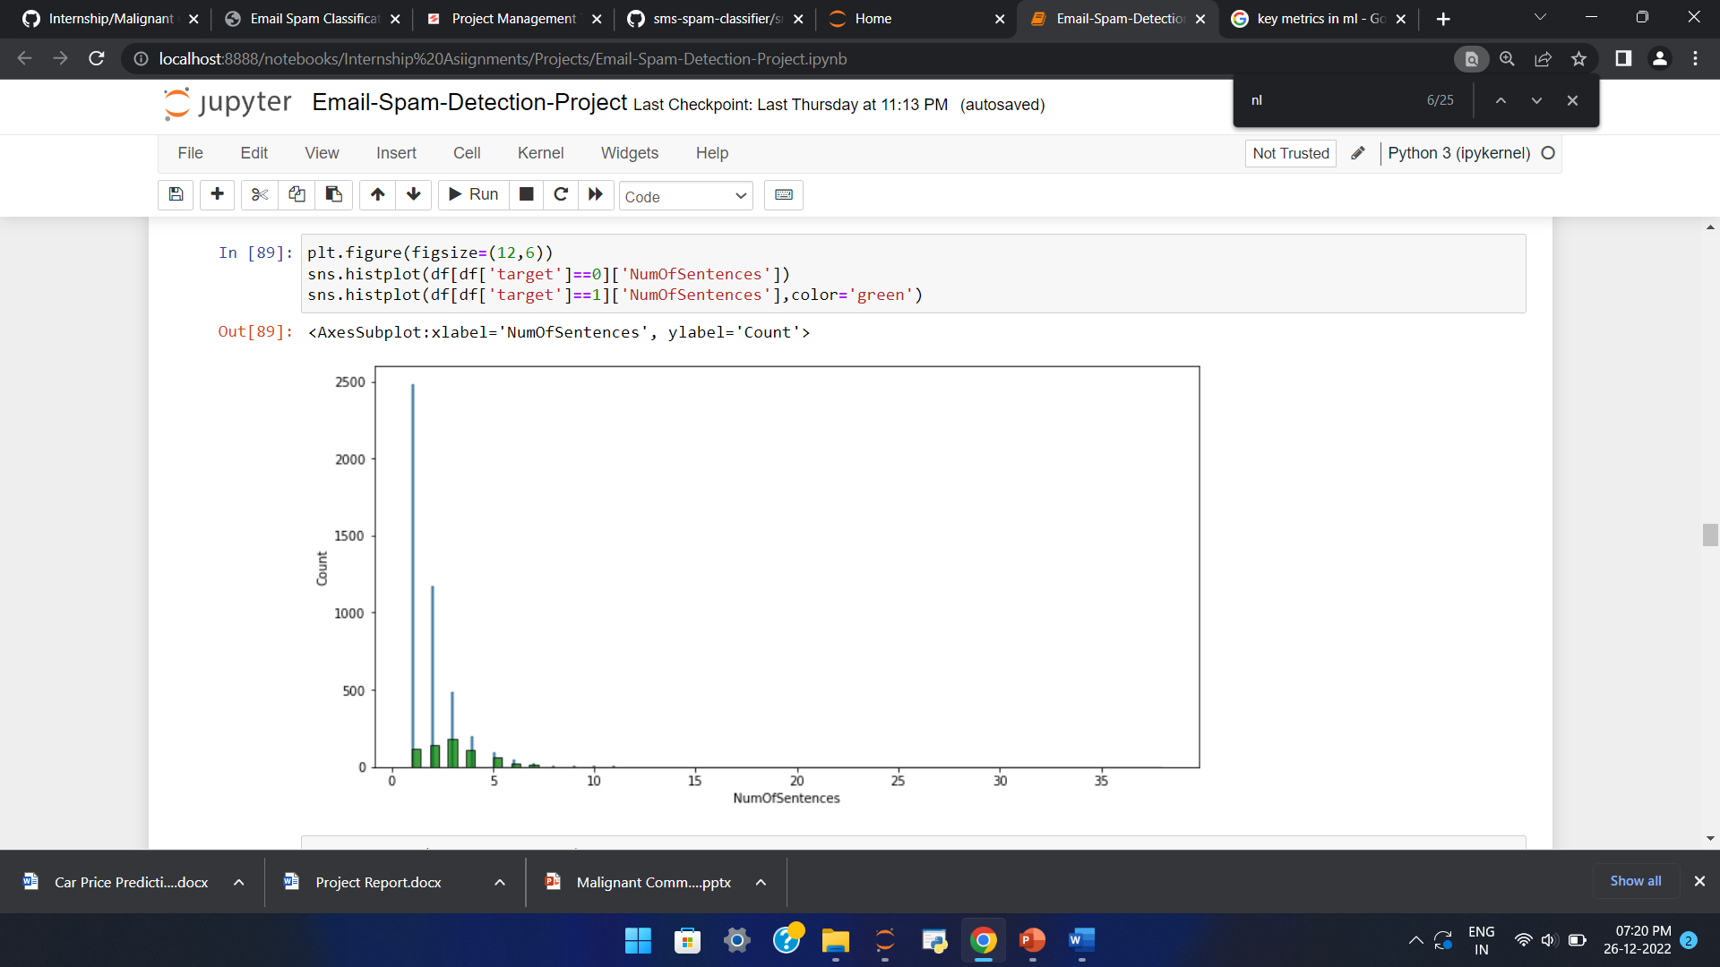
Above is a plot showing the comparison between number of sentences spam/ham emails consists of.
Majority of the spam emails contains greater number of sentences.

Slide 8
Data Pre Processing
Convert the text to lowercase
Remove the punctuations, digits and special characters
Tokenize the text, filter out the adjectives used in the review and create a new column in data frame
Remove the stop words
Stemming and Lemmatising
Applying Text Vectorization to convert text into numeric

Slide 9
Word Cloud

Slide 10
Word Cloud for getting word sense
Word Cloud is a visualization technique for text data wherein each word is picturized with its importance in the context or its frequency.
The more commonly the term appears within the text being analysed, the larger the word appears in the image generated.
The enlarged texts are the greatest number of words used there and small texts are the smaller number of words used.

Slide 11
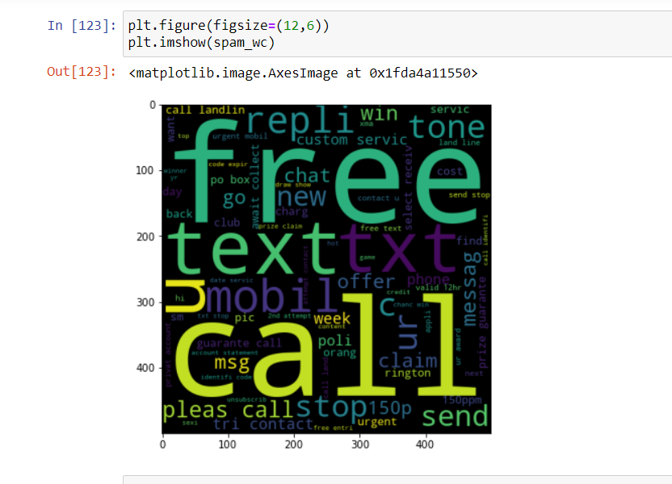
From word cloud of spam email classification, it is clear that it mostly consists of words like free, call, offer, claim, reply, guarantee call etc

Slide 12
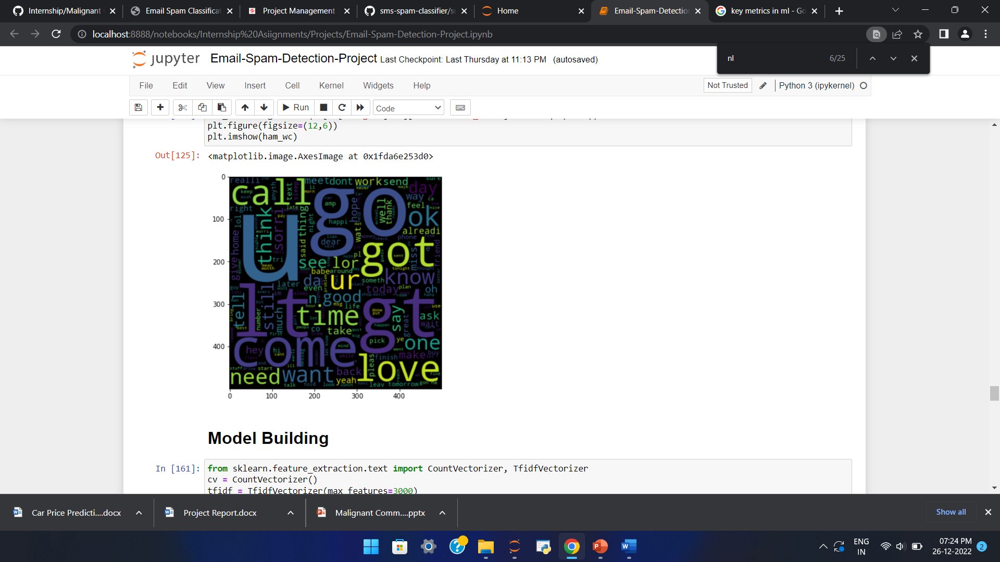
From word cloud of Ham emails, it is clear that it mostly consists of words like love, think, ok, day, thank, come, etc

Slide 13
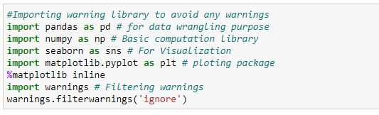
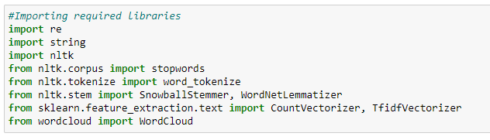
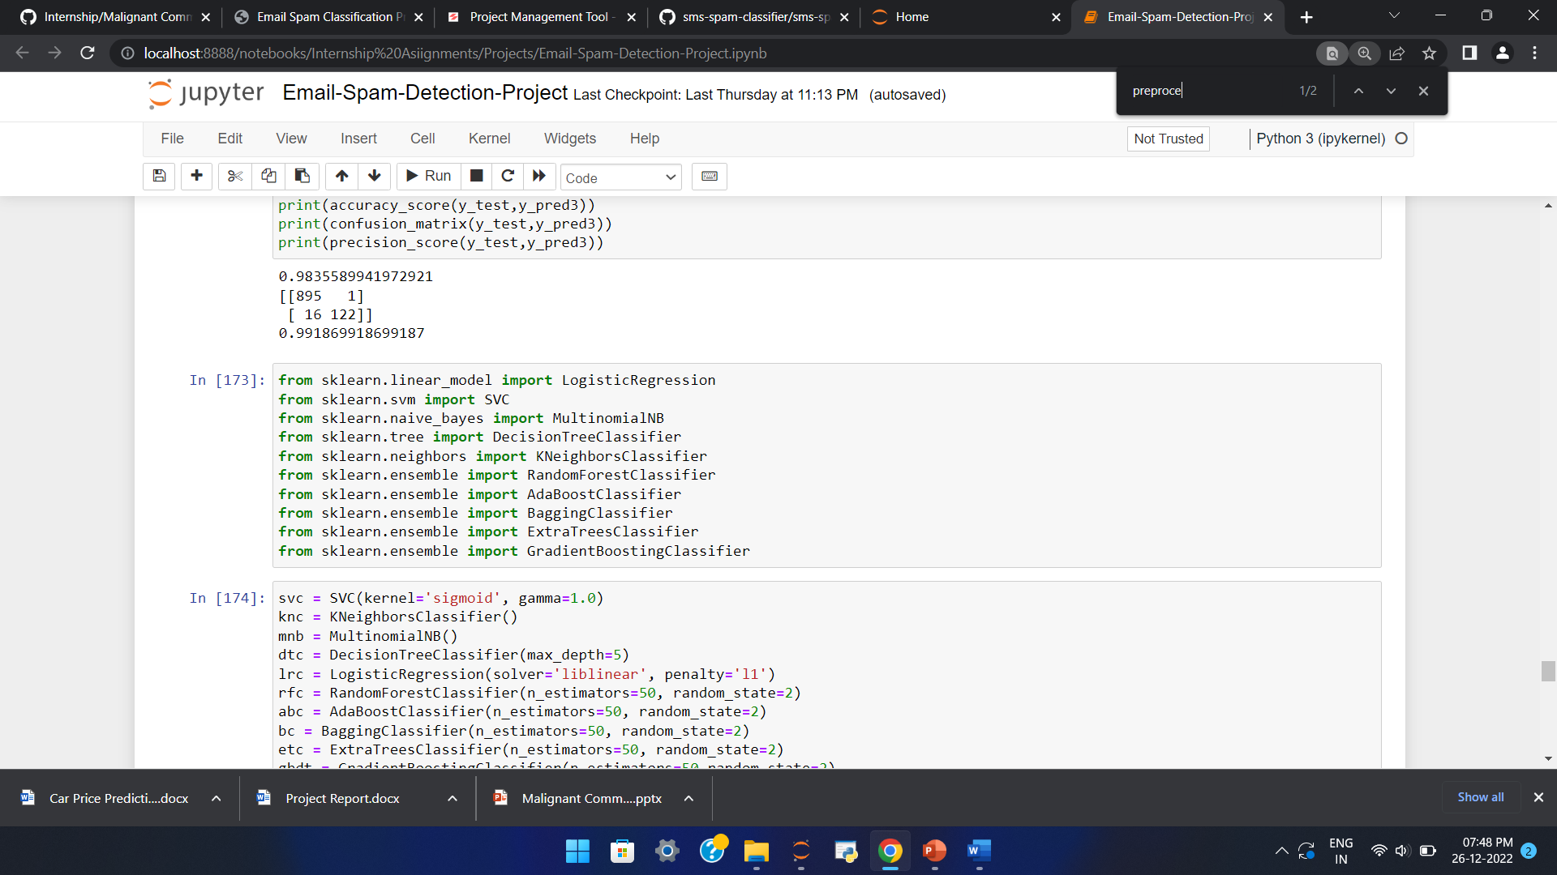
Visualization & Data Wrangling Library used
Text Mining Library used
Machine Learning Model Building Library used

Slide 14
Machine Learning Model Building

Slide 15
Machine Learning Model Building
The different classification algorithm used in this project to build ML model are as below:
Random Forest classifier
Support Vector Classifier
Logistics Regression
AdaBoost Classifier

Slide 16
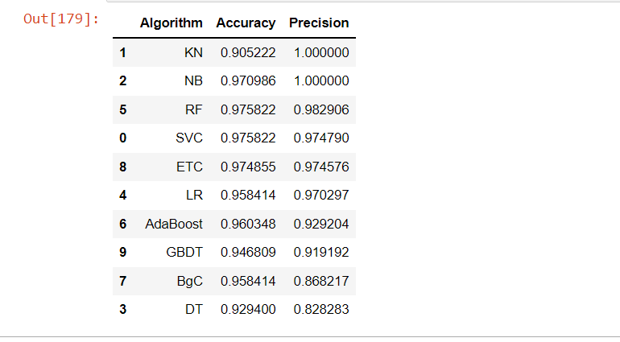
Final ML Model
Final Model - NB is giving us Accuracy score of 97.09% with 1.00 precision.

Slide 17
CONCLUSION
Multinomial Naïve Bayes performs better with Accuracy Score: 97.09 % and precision of 1.00 than the other classification models.

